Slide 1
GTK+
Gimp Tool Kit
Toolkit zur GUI-Programmierung
Verfügbar für Unix/Linuxsysteme, einschl. Mac und Windows
Basiert auf C
Tutorial:
https://developer.gnome.org/gtk3/stable/gtk-getting-started.html
Installation unter ubuntu mittels
  sudo apt-get install libgtk-3-dev
Alle Beispiele basieren auf dem o.g. Tutorium

Slide 2
Der Build Prozess
Ein einfaches Programm wird mit nachfolgendem Kommando kompilert:
gcc gtk1.c -o gtk1 `pkg-config --cflags --libs gtk+-3.0`
Dabei erzeugt pkg-config --cflags --libs gtk+-3.0 Commandlineoptions, hauptsächlich zu Includefiles ,ihren Verzeichnissen und Bibliotheken:
pkg-config --cflags --libs gtk+-3.0
-pthread -I/usr/include/gtk-3.0 -I/usr/include/atk-1.0 -I/usr/include/at-spi2-atk/2.0 -I/usr/include/pango-1.0 -I/usr/include/gio-unix-2.0/ -I/usr/include/cairo -I/usr/include/gdk-pixbuf-2.0 -I/usr/include/glib-2.0 -I/usr/lib/x86_64-linux-gnu/glib-2.0/include -I/usr/include/harfbuzz -I/usr/include/freetype2 -I/usr/include/pixman-1 -I/usr/include/libpng12 -lgtk-3 -lgdk-3 -latk-1.0 -lgio-2.0 -lpangocairo-1.0 -lgdk_pixbuf-2.0 -lcairo-gobject -lpango-1.0 -lcairo -lgobject-2.0 -lglib-2.0

Slide 3
Alles dreht sich um Widgets – was ist das?
Zusammensetzung aus
  Window (Fenster)
  Gadget (Vorrichtung, Gerät, Dingsbums, Apparatur, techn. Spielerei, ...)
Letzlich - Fenster mit einer speziellen Funktionalität
Widgets sind Buttons, Checkboxes, Eingabefelder (ein-/mehrzeilig) … oder Container
Synonyme Bezeichnungen sind Controlls, Components (java), Bedienelemente

Slide 4
Helloprogramm
#include <gtk/gtk.h>
int main( int argc, char *argv[] )
{
GtkWidget *window;
gtk_init (&argc, &argv);
window = gtk_window_new (GTK_WINDOW_TOPLEVEL);
gtk_widget_show (window);
gtk_main ();
return 0;
}
gtk_init(gint *argc, gchar ***argv)
GtkWidget *gtk_window_new (GtkWindowType type);
Erzeugt ein Toplevel-Window
void gtk_widget_show (GtkWidget *widget);
Wird als sichtbar markiert
void gtk_main (void);
Startet die mainloop der Applikation.
Programm bleibt in dieser Funktion
Bis zum Beenden

Slide 5
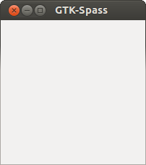
Ergänzungen
int main( int argc,
char *argv[] )
{
int i;
GtkWidget *window;
gtk_init (&argc, &argv);
for (i=0; i<argc; i++) puts(argv[i]);
window = gtk_window_new (GTK_WINDOW_TOPLEVEL);
//gtk_window_set_title((GtkWindow *)window,"GTK-Spass");
gtk_window_set_title(GTK_WINDOW (window),"GTK-Spass");
g_signal_connect (window, "destroy", G_CALLBACK (gtk_main_quit), NULL);
gtk_widget_show (window);
gtk_main ();
return 0;
}
#define g_signal_connect(instance, detailed_signal, c_handler, data)
Bewirkt, dass unser Window bei Auftreten eines „destoy“-Ereignisses
die Funktion gtk_main_quit(NULL) aufruft und damit nicht nur das
Hauptfenster schließt, sondern auch das Programm ordentlich
beendet.

Slide 6

int main( int argc,
char *argv[] )
{
int i;
GtkWidget *window;
GtkWidget *button;
gtk_init (&argc, &argv);
for (i=0; i<argc;i++)puts(argv[i]);
window = gtk_window_new (GTK_WINDOW_TOPLEVEL);
gtk_window_set_title(GTK_WINDOW (window),"GTK-Spass");
g_signal_connect (window, "delete-event", G_CALLBACK (on_delete_event), NULL);
g_signal_connect (window, "destroy", G_CALLBACK (gtk_main_quit), NULL);
gtk_container_set_border_width (GTK_CONTAINER (window), 10);
button = gtk_button_new_with_label ("Hello World");
g_signal_connect (button, "clicked", G_CALLBACK (print_hello), NULL);
g_signal_connect_swapped (button, "clicked", G_CALLBACK (gtk_widget_destroy), window);
//g_signal_connect_swapped (button, "clicked", G_CALLBACK (on_delete_event), window);
gtk_container_add (GTK_CONTAINER (window), button);
gtk_widget_show (button);
gtk_widget_show (window);
gtk_main ();
return 0;
}

Slide 7
Callback für Eventhandling
static gboolean
on_delete_event (GtkWidget *widget,
GdkEvent *event,
gpointer data)
{
g_print ("delete event occurred\n");
//return TRUE;
return FALSE;
}
static void
print_hello (GtkWidget *widget,
gpointer data)
{
g_print ("Hello World\n");
}

Slide 8
Mehrere Buttons
GtkWidget * gtk_grid_new (void);
  Erzeugt ein neues Widget (GridContainerWidget)
  Es können mehrere Widgets eingefügt werden
  Die Widgets werden in eine Gitterstruktur einsortiert
void gtk_container_add (GtkContainer *container, GtkWidget *widget);
  Fügt einen Container in ein anderes Widget ein, bei uns in das Hauptfenster
void gtk_grid_attach (GtkGrid *grid, GtkWidget *child, gint left, gint top, gint width, gint height);
  Fügt ein Widget (child) in den GridContainer ein

Slide 9
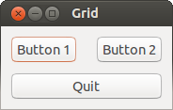
static void
print_hello (GtkWidget *widget,
gpointer data)
{
g_print ("%s\n",(char*)data);
}
Int main (int argc,
char *argv[])
{
GtkWidget *window;
GtkWidget *grid;
GtkWidget *button;
gtk_init (&argc, &argv);
window = gtk_window_new (GTK_WINDOW_TOPLEVEL);
gtk_window_set_title (GTK_WINDOW (window), "Grid");
g_signal_connect (window, "destroy", G_CALLBACK (gtk_main_quit), NULL);
gtk_container_set_border_width (GTK_CONTAINER (window), 10);
grid = gtk_grid_new ();
gtk_container_add (GTK_CONTAINER (window), grid);
button = gtk_button_new_with_label ("Button 1");
g_signal_connect (button, "clicked", G_CALLBACK (print_hello), "Hello 1");
gtk_grid_attach (GTK_GRID (grid), button, 0, 0, 1, 1);
button = gtk_button_new_with_label ("Button 2");
g_signal_connect (button, "clicked", G_CALLBACK (print_hello), "Hello 2");
gtk_grid_attach (GTK_GRID (grid), button, 1, 0, 1, 1);
button = gtk_button_new_with_label ("Quit");
g_signal_connect (button, "clicked", G_CALLBACK (gtk_main_quit), NULL);
gtk_grid_attach (GTK_GRID (grid), button, 0, 1, 2, 1);
gtk_widget_show_all (window);
gtk_main ();
return 0;
}

Slide 10
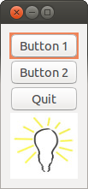
Anderes Layout
Widget GtkImage erlaubt das Einfügen von Bildern
Durch Einsetzen eines anderen Containers an Stelle von Grid wird ein anderes Layout erzeugt.
Andere Contaioner sind
  GtkListBox
  GtkFlowBox
  GtkPaned
  GtkNotebook
  . . .

Slide 11
int main (int argc, char *argv[])
{
GtkWidget *window;
GtkWidget *list;
GtkWidget *button;
gtk_init (&argc, &argv);
window = gtk_window_new (GTK_WINDOW_TOPLEVEL);
gtk_window_set_title (GTK_WINDOW (window), "Grid");
g_signal_connect (window, "destroy", G_CALLBACK (gtk_main_quit), NULL);
gtk_container_set_border_width (GTK_CONTAINER (window), 10);
list = gtk_list_box_new ();
gtk_container_add (GTK_CONTAINER (window), list);
button = gtk_button_new_with_label ("Button 1");
g_signal_connect (button, "clicked", G_CALLBACK (print_hello), "Hello 1");
gtk_list_box_insert (GTK_LIST_BOX (list), button,0);
button = gtk_button_new_with_label ("Button 2");
g_signal_connect (button, "clicked", G_CALLBACK (print_hello), "Hello 2");
gtk_list_box_insert (GTK_LIST_BOX (list), button,1);
button = gtk_button_new_with_label ("Quit");
g_signal_connect (button, "clicked", G_CALLBACK (gtk_main_quit), NULL);
gtk_list_box_insert (GTK_LIST_BOX (list), button,2);
GtkWidget *image;
image = gtk_image_new_from_file ("lampe.jpg");
gtk_list_box_insert (GTK_LIST_BOX (list), image,3);
gtk_widget_show_all (window);
gtk_main ();
return 0;
}

Slide 12
Layout generieren
Das gesamte Layout kann in einer XML-Datei beschrieben werden
Mittels GtkBuilder wird die gesamte Oberfläche generiert.
Die Applikation reduziert sich dann auf das Eventhandling
GtkBuilder *builder;
builder = gtk_builder_new ();
gtk_builder_add_from_file (builder, "gtk5.ui", NULL);

Slide 13
int main (int argc, char *argv[])
{
GtkBuilder *builder;
GObject *window;
GObject *button;
gtk_init (&argc, &argv);
builder = gtk_builder_new ();
gtk_builder_add_from_file (builder, "gtk5.ui", NULL);
window = gtk_builder_get_object (builder, "window");
g_signal_connect (window, "destroy", G_CALLBACK (gtk_main_quit), NULL);
button = gtk_builder_get_object (builder, "button1");
g_signal_connect (button, "clicked", G_CALLBACK (print_hello), NULL);
button = gtk_builder_get_object (builder, "button2");
g_signal_connect (button, "clicked", G_CALLBACK (print_hello), NULL);
button = gtk_builder_get_object (builder, "quit");
g_signal_connect (button, "clicked", G_CALLBACK (gtk_main_quit), NULL);
gtk_main ();
return 0;
}

Slide 14

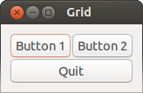
<interface>
<object id="window" class="GtkWindow">
<property name="visible">True</property>
<property name="title">Grid</property>
<property name="border-width">10</property>
<child>
<object id="grid" class="GtkGrid">
<property name="visible">True</property>
<child>
<object id="button1" class="GtkButton">
<property name="visible">True</property>
<property name="label">Button 1</property>
</object>
<packing>
<property name="left-attach">0</property>
<property name="top-attach">0</property>
</packing>
</child>
<child>
<object id="button2" class="GtkButton">
<property name="visible">True</property>
<property name="label">Button 2</property>
</object>
<packing>
<property name="left-attach">1</property>
<property name="top-attach">0</property>
</packing>
</child>
<child>
<object id="quit" class="GtkButton">
<property name="visible">True</property>
<property name="label">Quit</property>
</object>
<packing>
<property name="left-attach">0</property>
<property name="top-attach">1</property>
<property name="width">2</property>
</packing>
</child>
</object>
<packing>
</packing>
</child>
</object>
</interface>
GtkListBox
GtkGrid
Nicht validierendes XML
Datenauszeichnungssprache
Inhalte werden in 'Tags' verpackt
Ähnlich html
Ermöglicht den Einsatz von Oberflächengeneratoren
Ermöglicht Änderung der Oberfläche ohne neu zu kompilieren

Slide 15
Oberflächengenerator glade
Installation aus Package
Tutorial:
  http://www.micahcarrick.com/gtk-glade-tutorial-part-1.html
  (Versionsprobleme gtk+2.0 / gtk+3.0)
Die gespeicherte Datei liegt in xml vor, sie hat die Extension .glade, .ui oder .xml.
  gcc -Wall -g -o tutorial main.c `pkg-config --cflags --libs gtk+-3.0` -export-dynamic
Das c-Programm ähnelt dem von Folie 13

Slide 16
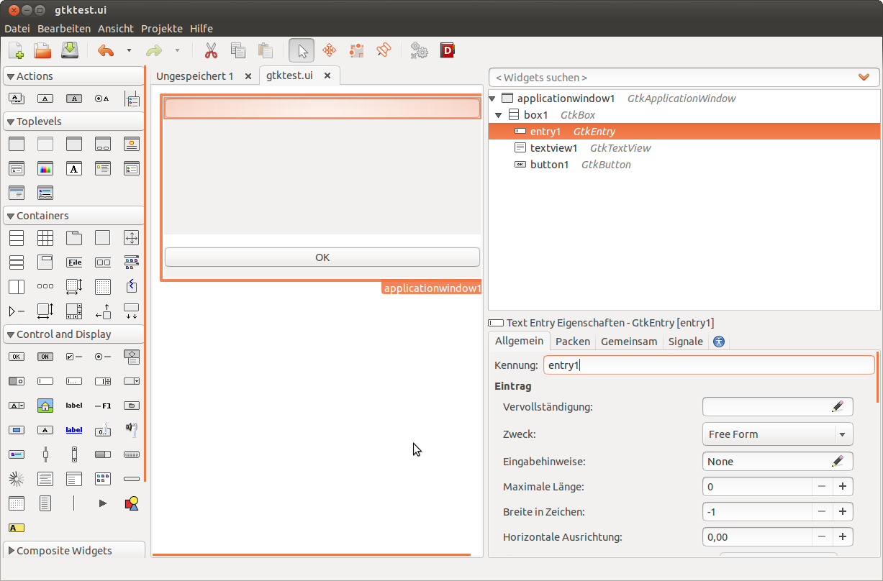

Slide 17
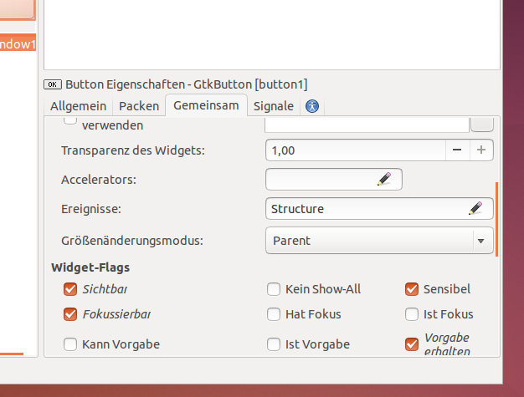
Arbeitsschritte
Applikationsfenster von Auswahl nach Arbeitsfläche ziehen
Eigenschaften einstellen (wichtig: Gemeinsam: sichtbar)
Weitere Controlls und Layouts einfügen
Speichern unter .ui, .xml oder .glade

Slide 18
// aus Tutorial http://www.micahcarrick.com/gtk-glade-tutorial-part-1.html
// gcc -Wall -g -o gtkfolie gtkFolie.c `pkg-config --cflags --libs gtk+-3.0` -export-dynamic
#include <gtk/gtk.h>
void on_window_destroy (GtkWidget *object, gpointer user_data)
{
gtk_main_quit ();
}
int
main (int argc, char *argv[])
{
GtkBuilder *builder;
GtkWidget *window;
gtk_init (&argc, &argv);
builder = gtk_builder_new ();
gtk_builder_add_from_file (builder, "gtktest.xml", NULL);
window = GTK_WIDGET (gtk_builder_get_object (builder, "window"));
gtk_builder_connect_signals (builder, NULL);
g_object_unref (G_OBJECT (builder));
gtk_widget_show (window);
gtk_main ();
return 0;
}

